Slide 1
A Brief History of the Technical Development of SuperDARN
Ray Greenwald

Slide 2
Objectives
Describe how the design and operation of the SuperDARN radars have evolved from the installation of the Goose Bay radar (1983) to the present day.
Describe early SuperDARN meetings, activities, decisions and recommendations
Leicester – 1992
Saskatoon – 1993
Point out recent changes in hardware and software design philosophy.
Present some of my concerns.

Slide 3
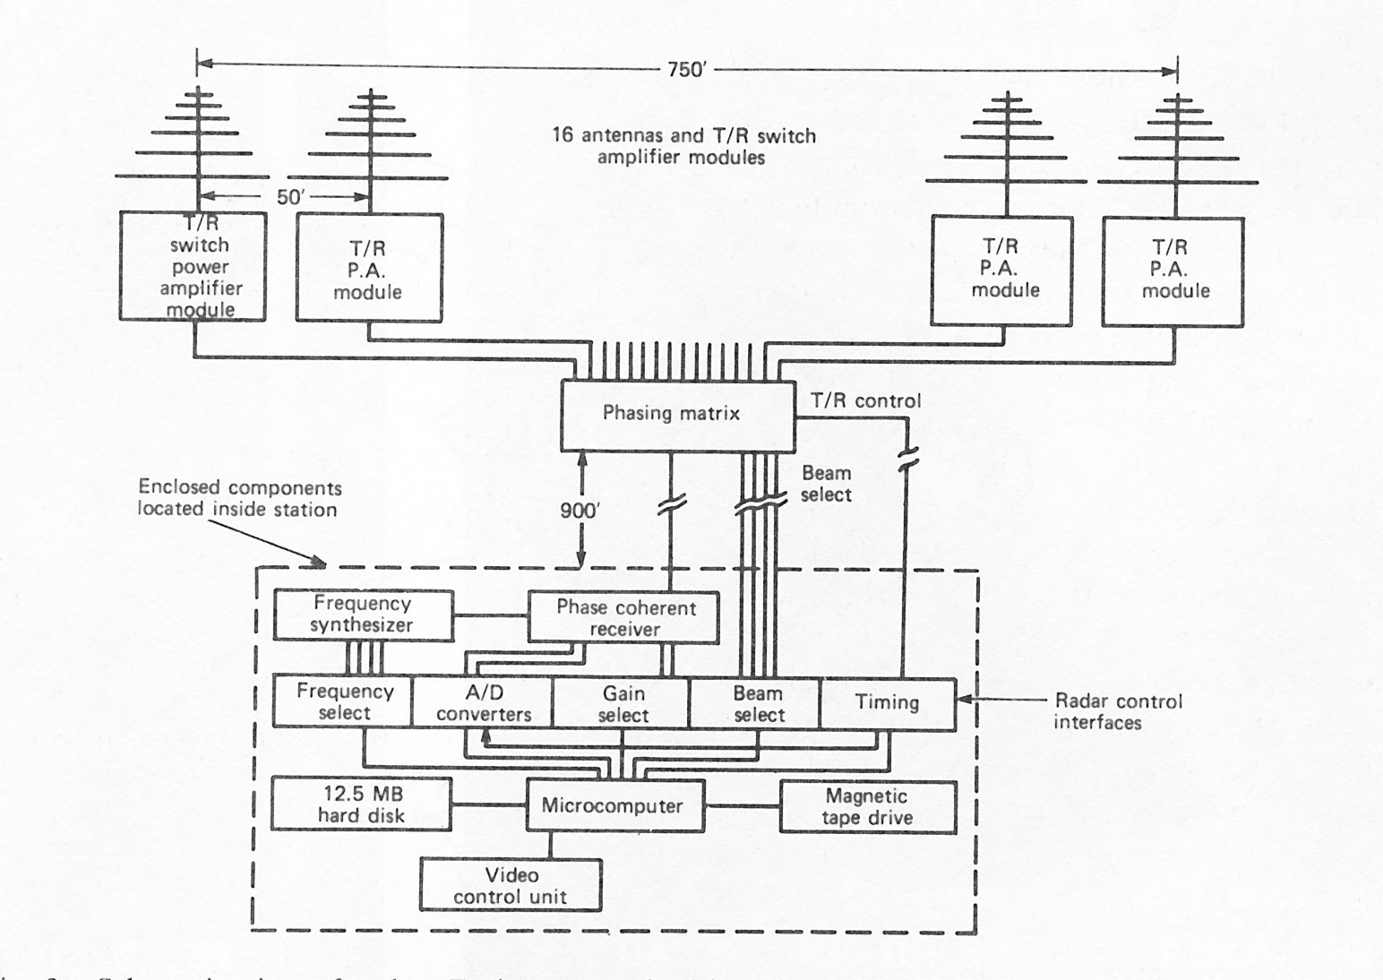
Hardware Schematic of Goose Bay Radar ca. 1983
Transmitters output: 75-150W Phasing matrix made from lengths of cable and switches
Used Data General Minicomputer, fabricated hardware interface cards with modular ADCs.
Programming done in assembly language by Kile Baker and Ray Greenwald

Slide 4
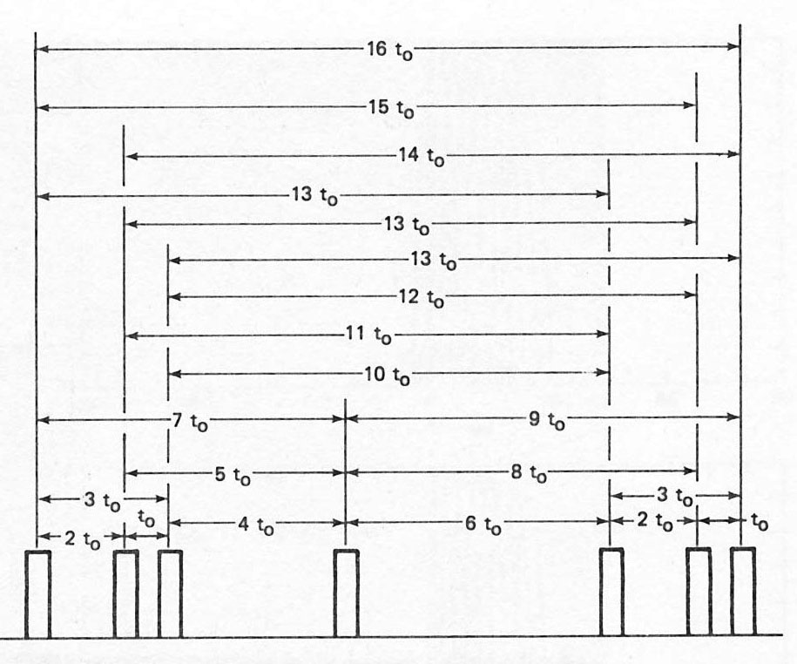
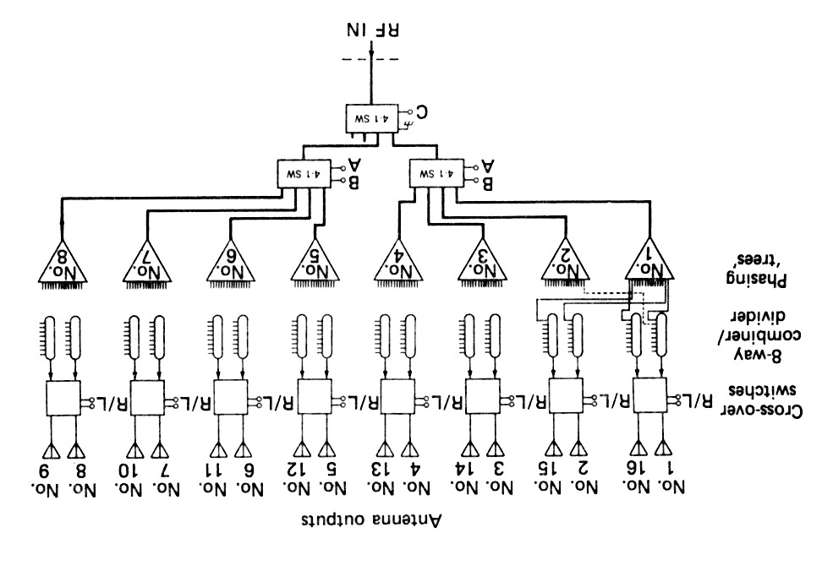
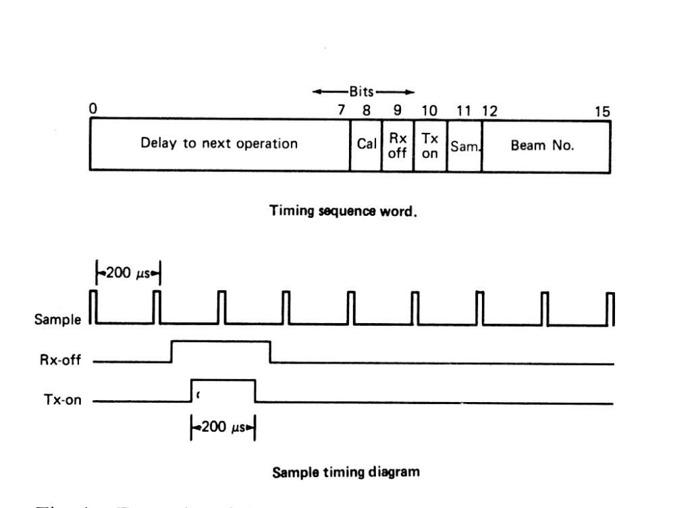
Hardware Details of Goose Bay Radar ca. 1983
Multipulse Sequence
Original Phasing Matrix
Phasing “trees” are groupings of 16 cables. Each grouping is cut to direct and receive signals from a specific viewing direction.

Slide 5
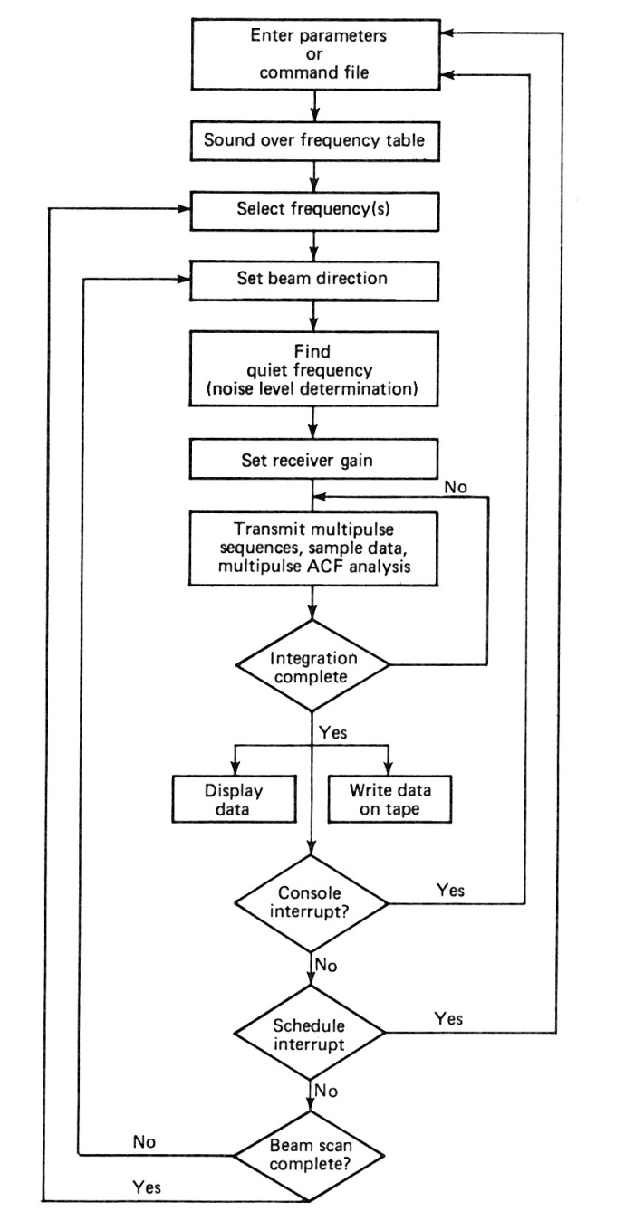
Initial Software Flow Diagram for Goose Bay Radar ca. 1983
Programmed in Assembly Language on Data General MicroEclipse Computer
by
Kile Baker, Ray Greenwald?, others?
Original fclr Subroutine
This part of the program created a timing sequence and clocked it out to a DIO interface board, sampled and digitized data and read it into memory via DMA (ADC interface board). ACFs were calculated for each multipulse sequence and summed over the integration period. (original acfcalculate).
Original tdisplay
Data plotted and stored on magnetic tape
This system had two hardware interfaces:
DIO for outputting radar control parameters
Timing sequence
Phasing matrix beam selection
First local oscillator frequency
Receiver attenuation
ADC for inputting the received data

Slide 6
Schefferville Radar ca. 1987
This radar was established at Schefferville, Quebec by Christian Hanuise and Jean-Paul Villain to provide common volume radar measurements with the Goose Bay radar.
Similar to Goose Bay radar
Only 8 antennas in phased array
First implementation of phasing matrix with capacitive delay lines
The Schefferville radar was decommissioned when the Stokkseyri (Iceland West) radar was put into operation

Slide 7
Halley Radar ca. 1988
Polar-Angloamerican Conjugate Experiment (PACE)
Facility funded jointly be UK and USA to obtain conjugate measurements of plasma convection in the northern and southern hemisphere polar regions.
PACE provided the first observations of the dynamics of plasma convection in conjugate hemispheres.
Hardware and Software Innovations
Improved analog HF receiver
~600 W Transmitters
Transition to dual 286/386 PCs using QNX Operating System
One PC provided signals to sequence radar operations and control radar hardware
Software development carried out by Kile Baker
Interfacing of radar hardware provided by the BAS box
PACE radars continued to have two hardware interfaces
DIO: PIO48C interface card on Timing Computer
ADC: DT2828 interface card on Main QNX Computer (Replacement for original ADC card)

Slide 8
SuperDARN Era 1991
At a DARN radar meeting held in Lindau, West Germany, a number of participants agreed to try to obtain funding for the development of a large-scale network of HF radars sharing common viewing areas.
A second meeting was held several months later at JHU/APL in the USA.
Participating countries:
Canada, France, UK, USA, Japan?, South Africa?
After much discussion, participants agreed that;
French scientists would construct a radar in Iceland that would share a common volume with the existing Goose Bay radar.
Canadian and US scientists would construct two pair of radars with common viewing areas over central and western Canada.
British scientists would construct a pair of radars with a common viewing area over northern Scandinavia and extending northward to Svalbard.
A follow-up meeting would be held at Leicester University in the Spring of 1992 to discuss:
Funding progress, radar configuration, construction, and operations, and analysis techniques

Slide 9
Leicester University 23-24 April 1992
This meeting is probably the most important that took place in the history of SuperDARN
There was substantial involvement by all participants in defining SuperDARN as it came to be know in the years ahead.
Radar Status Reports
Funding approved in Canada, France.
Leicester University received funding approval after the meeting
Ray Greenwald identified as confident of getting funding, but no sponsor was listed
Eventually, NASA funded the construction of the Kapuskasing radar.

Slide 10
Leicester University 23-24 April 1992
WG1: Radar Configuration
Antenna provider: Sabre Communications Corp.
Transmitters
Receiver
Phasing matrix
Interfaces
Performance monitoring
On-line processing
Data storage
Radar control software
Provided by Simon Wing and Kile Baker, JHU/APL

Slide 11
Leicester University 23-24 April 1992
WG1: Radar Configuration
CNRS/LCPE, JHU/APL, and U. of Saskatoon agreed to share in the development of 3 identical radars.
CNRS/LPCE to fabricate the receivers and phasing matrices
Receiver: PACE design with minor modifications
Phasing matrix: Refined Schefferville design
JHU/APL to provide computers, frequency synthesizers, Tx power supplies, digital interface box (BAS), cables
U of Saskatoon to provide all of the transmitters
New driver amps and power amps
New forward and reflected power monitor
New low-pass filter
APL-designed switches and AGC module
Leicester U. eventually constructed their own system
Many designs similar to consortium design (Same interface controls)
More elaborate AGC module that allowed remote monitoring of signals
Optical disks were selected for data storage at the radar sites.

Slide 12
Leicester University 23-24 April 1992
WG2: Radar Operations
Radar scanning modes
No more than 3 generic common programs
Time allocation
Common: 50%, Special: 20%, Discretionary: 30%
Data merging
Data distribution
Exabyte tape
ISTP/GGS Key Parameters
Data usage
Availability of data to the general community
Data flow plan
Data distribution to the SuperDARN community
Production of Key Parameters for the NASA ISTP/GGS Mission

Slide 13
Leicester University 23-24 April 1992
WG3: Radar Construction
Site location requirements
Pointing directions of new radars
Site sharing constraints/benefits
Construction collaboration
Testing and calibration of new radars
It is important to stress that adequate documentation and test procedures are necessary for a collaborative development of this type. It is agreed that suitable documentation be provided for all items supplied to other groups.
Construction concerns
Scheduling of radar deployment

Slide 14
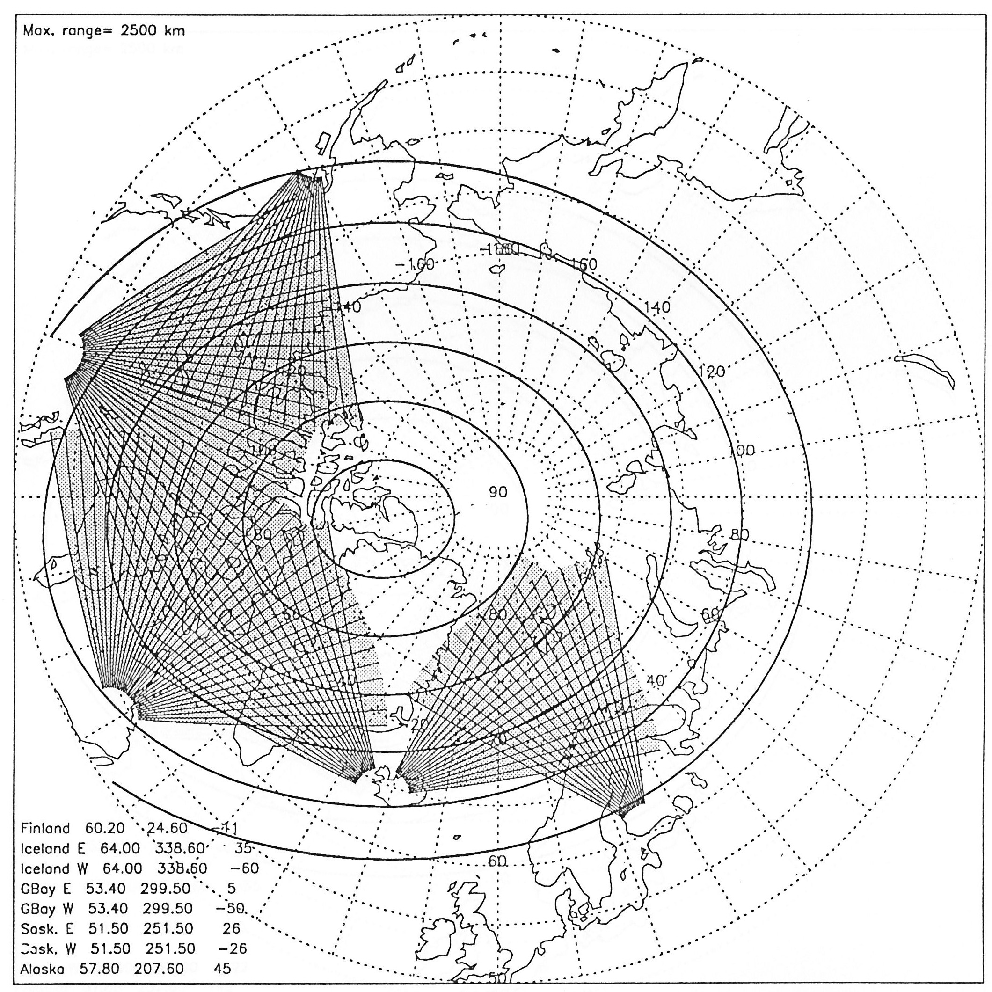
Deployment Plan at Leicester University Meeting

Slide 15
Leicester University 23-24 April 1992
WG4: Data Analysis
Fitacf
Kile Baker responsible for updating fitacf for SuperDARN
Data merging algorithms
Merging algorithm working group: Mike Pinnock, chair
2D data representation
Plotting & software working group: Kile Baker, chair
General purpose analysis software (e.g. IDL)
SuperDARN specific analysis software
Plotting & software working group: Kile Baker, chair
Sharing software development responsibilities
The Ten Commandments
Software restrictions imposed by Moses Baker
e.g. Thou shalt not touch “rbpos”.

Slide 16
Leicester University 23-24 April 1992
Summary Comments
The Leicester meeting was notable for the level of enthusiasm and participation by all participants
Design of the planned radars remained very similar to that of the PACE radars
Hardware interfaces for the DIO and ADC cards, the phasing matrix, and the receivers were unchanged.
Over the next year, Leicester engineers developed an ISA-standard PC card for GPS Time and associated driver software.
For the most part:
The SuperDARN era began with no major changes to the radar hardware control software.
Significant improvements made by Kile Baker to “fitacf”.
Significant developments were required to produce analysis software based on “merging” data from two radars.
Proposals to develop and implement radar calibration software and test procedures were either ignored or forgotten.
Our Philosophy: Radars operating well if they produced interesting data!

Slide 17
University of Saskatchewan 28-29 April 1993
One year later in Canada …….
Funding had been received for NE-directed radar in Saskatoon
Antenna arrays and building constructed
Antenna arrays and building for NW-directed radar constructed in late 1992 near Kapuskasing, Ontario.
40 Hectares of land purchased by JHU.
Everything ready except possibly the NASA funding?
Final installation of both radars planned for July 1993.
Note! Both radars were put into operation over a two-week interval.
Week 1: Installation of Saskatoon electonics.
Week 2: Installation of Kapuskasing electonics.
Only one interface minor issue
Unfortunately, lightning damage shut down the Kapuskasing radar after 1 week of operation and the Saskatoon radar about 2 months later.

Slide 18
University of Saskatchewan 28-29 April 1993
Iceland West Radar
At the meeting, the French team presented an ambitious plan in which construction of the radar would begin in September 1993.
Unfortunately, the licensing authority in Iceland rejected the original site.
A new site was found southeast of Reykjavik and construction began ~1 year later.
Cutlass Radars
Plans presented for construction and deployment of the Leicester radars in Iceland and Finland
Schedule for the deployment of the radars in Iceland and Finland were scheduled for the late Autumn of 1994 and 1995, respectively.

Slide 19
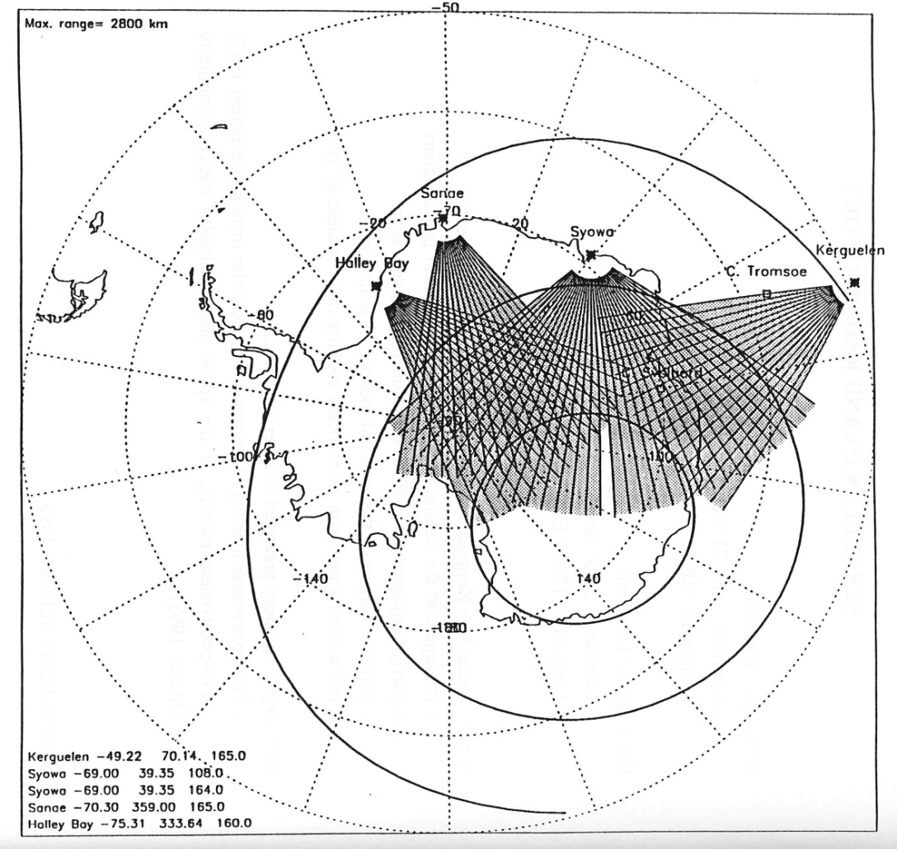
University of Saskatchewan 28-29 April 1993
Other new SuperDARN radars discussed at this meeting
King Salmon Alaska: Bob Hunsucker
Syowa Station, Antarctica (2) Hisao Yamagishi
SANAE Station, Antarctica Dave Walker
Kerguelen Island Jean-Paul Villain

Slide 20
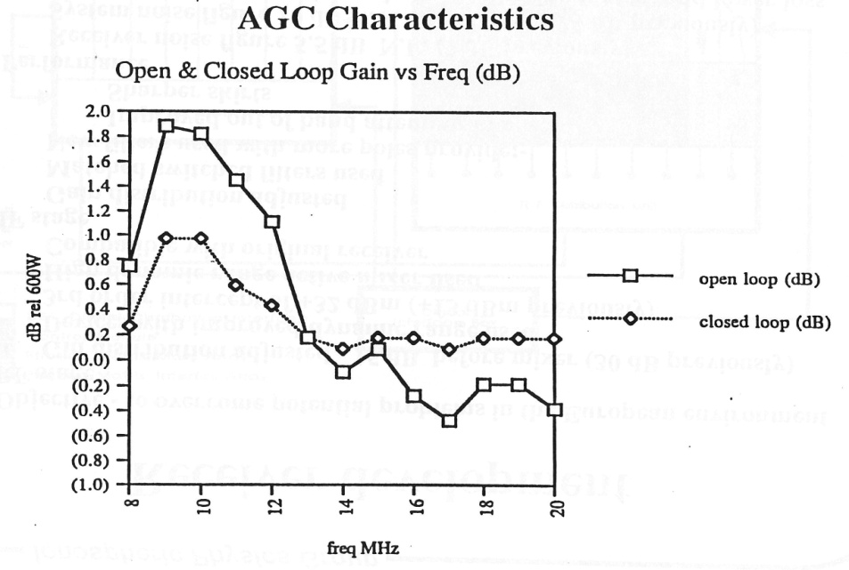
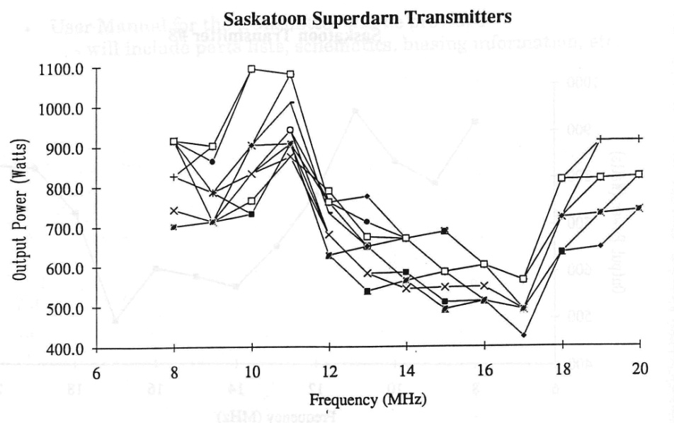
University of Saskatchewan 28-29 April 1993
There were many hardware discussions
Transmitters
Receivers
Phasing matrix
While the hardware elements of the new radars had minor RF differences, they were subject to the same digital control signals making them easy to integrate into the radar control software.
The monitoring capabilities of the Leicester AGC modules were independent of the standard SuperDARN software package.
Leicester Transmitters

Slide 21
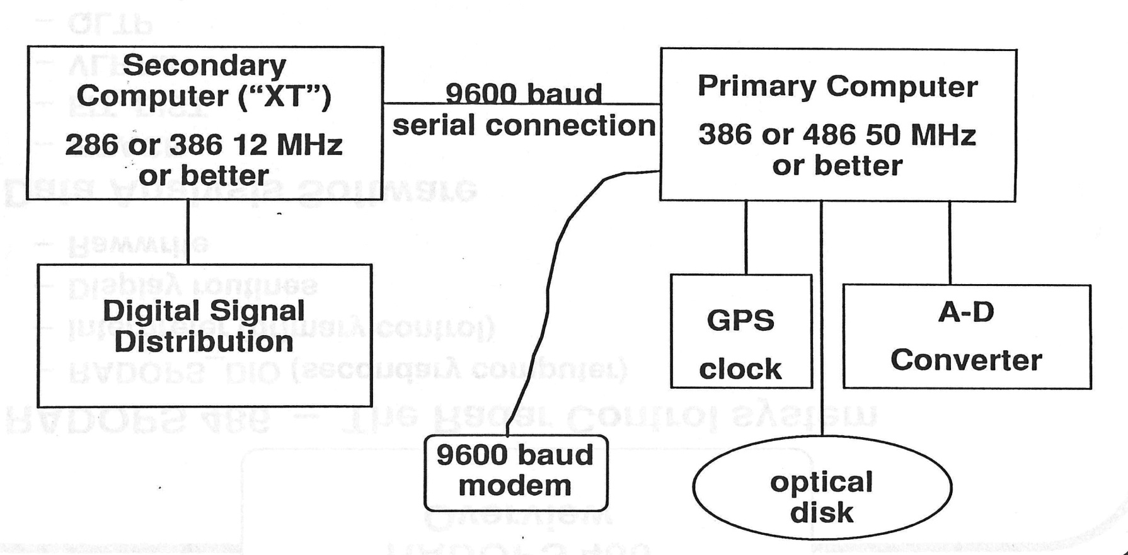
University of Saskatchewan 28-29 April 1993 Basic Hardware Description from the Programmers Perspective
The rest of the radar

Slide 22
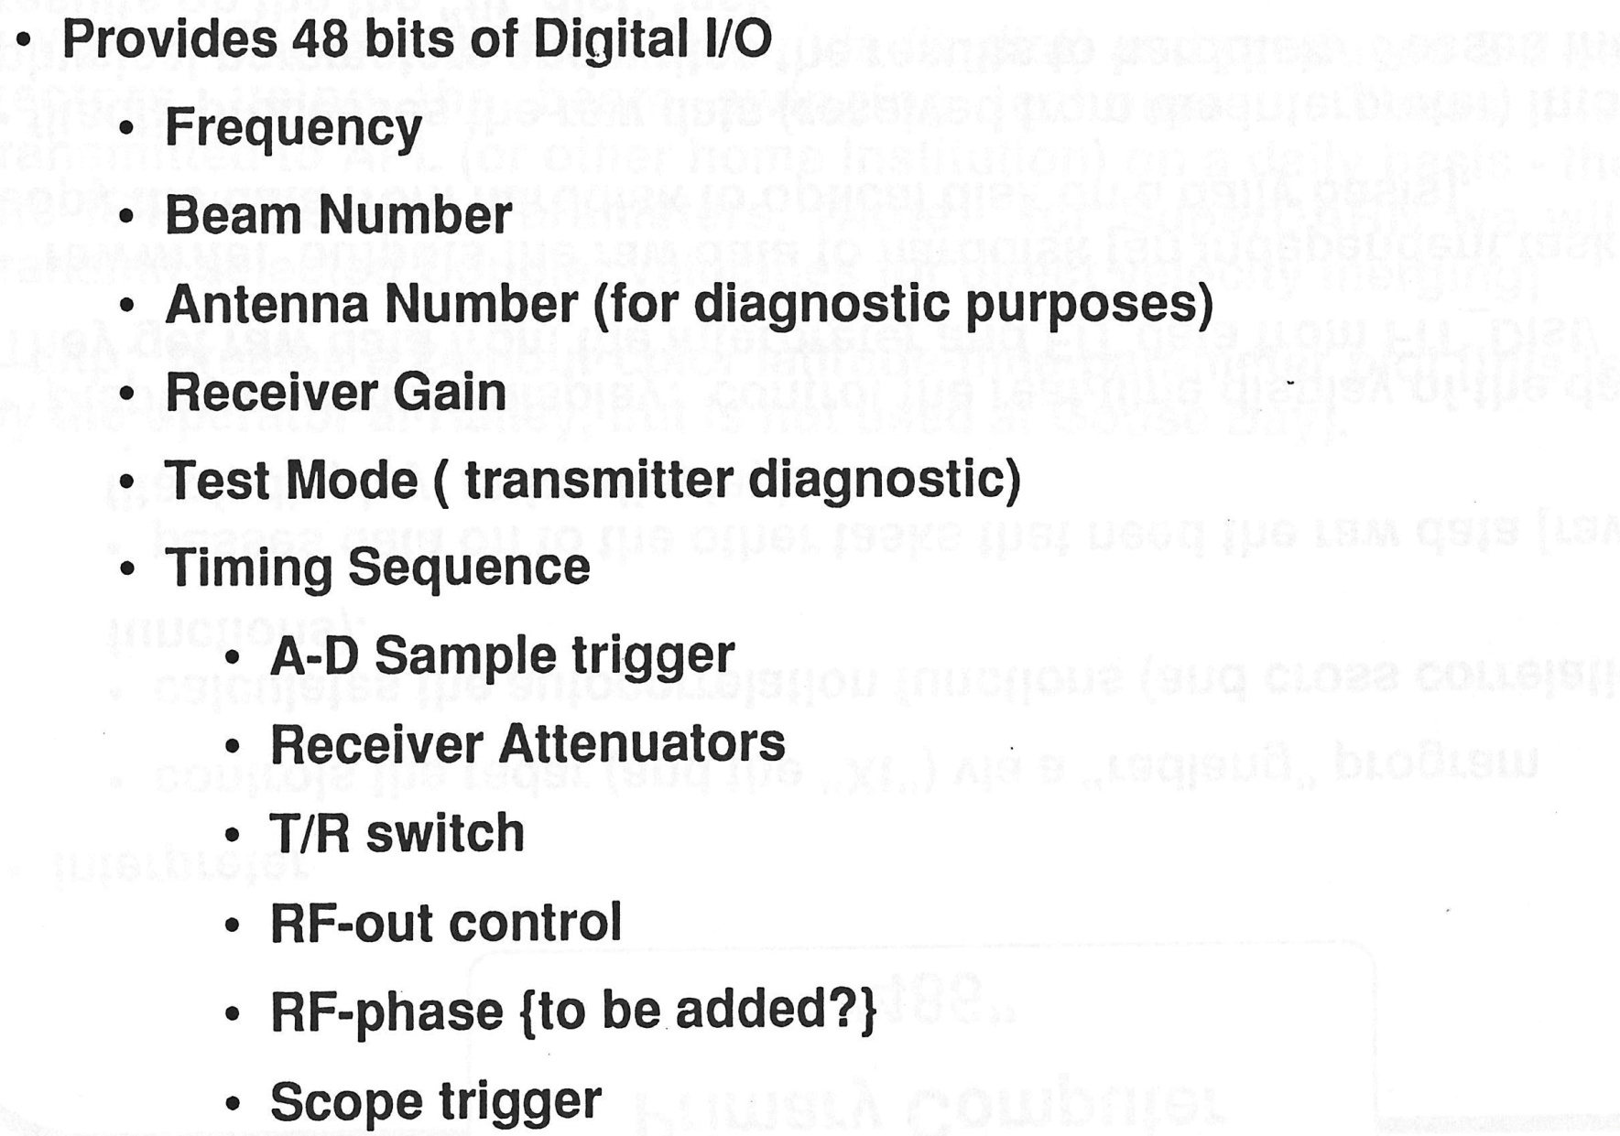
University of Saskatchewan 28-29 April 1993 XT Digital IO

Slide 23
University of Saskatchewan 28-29 April 1993 386/486 Main Computer

Slide 24
Kiljava, Finland May 2003
We move forward 10 years ……
14 of the original 16 SuperDARN radars are in operation
All have the same electronic interfaces
All operate using RADOPS heritage software, probably RADOPS/2000
RADOPS 386 First version written for PC, uses RADLANG interpreter
RADOPS 486 Upgrade for 486 PC, uses RADLANG interpreter
RADOPS/2000 Switched from RADLANG interpreter to C compiler
Rob Barnes came to APL in 1995/1996
This software was the product of a Baker/Barnes collaboration and mainly written by Rob Barnes and implemented in 1996
Data were output to CDs and mailed to home institutions
Software included a Reference Manual and Support Library Manual.
One notable presentation at this meeting is that Todd Parris and Bill Bristow introduced new observations obtained with a GC214/TS digital receiver.
Todd wrote the hardware drivers for this card and hacked them into the RADOPS/2000 software.

Slide 25
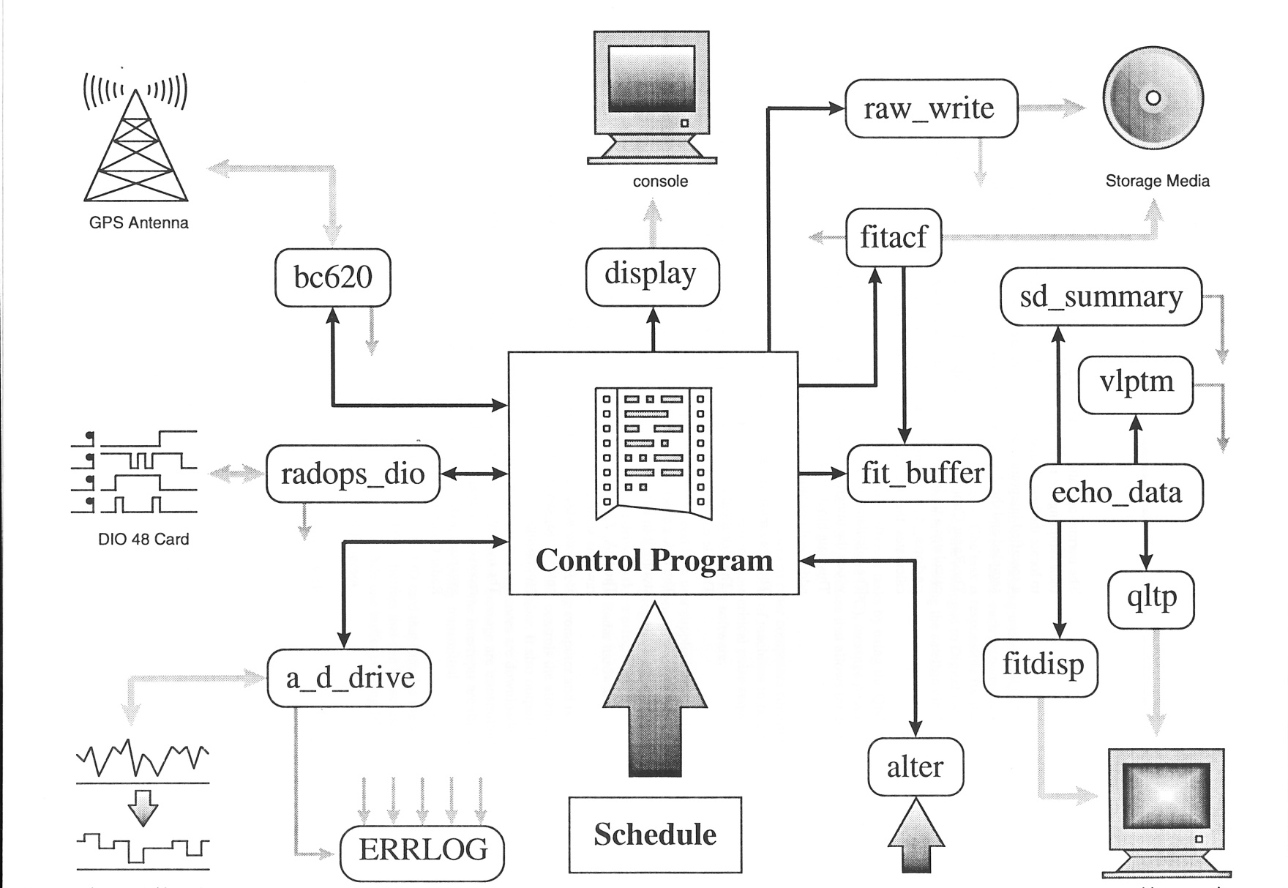
RADOPS/2000 Software Flow
DT2828 Card

Slide 26
Saskatoon, Canada May 2004 Presentation by Rob Barnes
Radar Operating System must be migrated from QNX4
Work so far completed:
Installation of QNX6 development system
Detailed review of software issues involved
Porting and testing of core SuperDARN libraries to QNX6
Modification of software to allow for multiple targets
Source contains pre-processor conditionals that that allows different code to be compiled on either QNX4 or QNX6
This means that both QNX4 and QNX6 can be supported during the transition.

Slide 27
Saskatoon, Canada May 2004 Presentation by Rob Barnes
Radar Hardware is evolving rapidly
Different interface Cards
Datel A/D Card or equivalent
Need a PCI replacement for PIO48C
Stereo systems
Digital receivers
Require major software modifications
Digital Phasing
Digital Beam Forming

Slide 28
Saskatoon, Canada May 2004 Presentation by Rob Barnes
There is a real danger that the software will splinter
SuperDARN only works because everybody uses the same software.
Strong configuration management
Centralized software development and distribution
Compatibility of Control Programs
A Control Program written on radar X must work on radar Y without modification

Slide 29
Saskatoon, Canada May 2004 Presentation by Ray Greenwald
8-20 MHz Bandpass Filter
Phasing matrix
Digital Receiver
RF Amp
GC214/TS
40.625 MHz
Kodiak Implementation
40.625 ±0.5 MHz Bandpass Filter
Phasing matrix
Old Analog RF Amplifier
Modified IF Amplifier
Digital Receiver
GC214
50.625 MHz.
1st Local Oscillator
Goose Bay Implementation
These two implementations of the digital receiver require different drivers !

Slide 30
How Complex is the Driver Issue?
Consider the following matrix
Non-Stereo Radar Stereo Radar
HF Band Analysis IF Band Analysis
GC214 Card GC214/TS Card
Each radar in the top row can pair with either analysis mode in the second row and either card in the third row. There are 8 possible drivers!
Currently, the manufacturers primary product is a GC314 Card which comes in a variety of formats. The MSI radars use these cards.
The Australians are fabricating their own digital receiver cards. Who is producing their drivers and how will they be integrated with ROS.

Slide 31
Another Example of Driver Proliferation
Phasing Matrix
In 2005, I designed and Kjellmar Oksavik constructed a new type of phasing matrix for the SuperDARN radars
Operates on principal of phase shift steering
Any steering angle can be obtained, but for compatibility with other SuperDARN radars, we have used a rotation of 3.24º between beam directions.
We calculate the phase shift to produce this rotation angle and an analog RF network creates multiples of this basic phase shift and mixes them onto the RF signals that are being transmitted or received.
Instead of outputting a beam number to the phasing matrix, we output two 50.625 MHz signals that have the calculated phase shift.
Initially, the University of Saskatchewan used the same technique for their PolarDARN radars. However, they have recently replace the analog part of the system with an array of DDS chips which are programmed to provide the correct phase to each antenna.
This system requires a completely different driver.

Slide 32
Another Example of Driver Proliferation
For the MSI radars, Bill Bristow and Todd Parris redesigned the traditional capacitive delay line phasing matrix so that it could be stepped through any set of beam directions.
i.e, the beam directions are not restricted to multiples of 3.24°.
This new time-delay matrix requires a completely different driver and it requires an elaborate calibration process.

Slide 33
MSI: How Current Technical Development is Changing the Nature of SuperDARN
Consider the hardware and software development for the MSI radars.
Each phasing matrix in the MSI radars is controlled by 2 50-pin scsi cables. Each pair of cables is presumably connected to a DIO card in the QNX6 computer
The software drivers controlling these signals were written by the UAF group and are sited and maintained at UAF.
The MSI radars use GC314 digital receivers in the QNX6 computer.
The software driver for these receivers is sited and maintained at UAF.
The MSI RXFE is presumably controlled by another DIO card in the QNX6 computer.
The software driver for the RXFE is sited and maintained at UAF.
The MSI timing sequence is provided by a timing card in the QNX6 computer .
The software driver for the timing card is sited and maintained at UAF.
The software for the MSI radars has been developed at two institutions
QNX6 machine acquires the data.
Hardware and software developed by UAF
Linux machine controls radar operation, processes and distributes data
Software developed at APL by Rob
Neither side fully understands what the other has done!

Slide 34
Other Scoundrel Awards
Ray Greenwald
For redefining control signals in the DIO interface so as to enable the operation of the Wallops phasing matrix
The University of Saskatchewan
This honor is awarded for their previous development and continued use of GC214HFdrivers for several Canadian radars
And, their current development of drivers for a DDS-controlled phasing matrix.
The Engineering School of LaTrobe University
For producing a SuperDARN radar that requires a totally new set of software drivers.

Slide 35
Where are we Now?
Woe to us! Pandora has opened her box and all of the evils of technology have escaped.
How do we retain the integrity of the SuperDARN data products?
How can we be sure we have maintained the integrity of the data products?
Last year, Rob described the next generation of software as a Linux/QNX6 mix
Hardware developers could write their own software on the QNX6 side and
Rob would maintain the radar control, scheduling, and processing on the Linux side
How has this worked out to date? Poorly
No overall architecture definition
No interface requirements
No documentation requirements
No management plan for the resulting software
This is not only a QNX6/Linux problem
How do we assure the continued viability of the QNX4 software in the face of many new hardware drivers.

Slide 36
Why did I want an IF Driver for the Digital Rx?
With an analog receiver, the output signal has a narrow bandwidth making it is easy to see backscattered returns as a function of range or delay.
It is also easy to identify transient disturbances as they occur
With a digital receiver, we can only observe the signals that are being input to the receiver and the digitally processed output.
If we are processing in the HF band, the input signal has a bandwidth of ~10 MHz and contains powerful transmissions from almost anywhere in the world.
These transmissions include the HF broadcast bands, air traffic communications, naval communications, radar transmissions, beacons, etc.
Spectral content due to backscattered radar signals of interest is extremely tiny.
If we are processing at an IF frequency we can substantially narrow the spectral content of the signal being input to the digital receiver and remove a substantial fraction of the unwanted manmade noise.
It is possible to visually detect strong radar returns on an oscilloscope before the signal is digitally processed.
With the MSI radars we are comparing the effectiveness of the HF and IF modes of operation.

